Slide 1


EQUITY RESEARCH NEWS TOOL
Using LLMs and Lang Chain to Summarize News
Upasna Agrawal

Slide 2
PROJECT OVERVIEW
Objective:
To build an AI-powered tool that fetches and summarizes news using LLMs, helping users stay updated on market trends.
Tech Stack:
Streamlit (Web UI)
Lang Chain (LLM Framework)
Grok Model and GROK_API_BASE and Grok key
Python
Using HTML CSS for designing

Slide 3
PROBLEM STATEMENT
News is:
Too voluminous
Hard to filter
Time-consuming to read
Goal: Automatically summarize relevant news using AI.

Slide 4
KEY FEATURES
🔍 Query Input: Ask about any news or topic.
🔥 Trending Topics: Quick-access hot trends.
📰 Summarized Output: AI-generated summary of given query /news.
🎨 Attractive UI: Modern layout using Streamlit & CSS.

Slide 5
ARCHITECTURE DIAGRAM
Input ➜ News API/Scraper ➜ Lang Chain ➜ GPT ➜ Streamlit UI

Slide 6
CODE HIGHLIGHT
# ---- for using Title ----
st.markdown('<div class="big-title">📈 Equity Research News Tool</div>', unsafe_allow_html=True)
st.markdown('<div class="subtext">Enter your query to get the latest news summarized .</div>', unsafe_allow_html=True)
# ---- Trending Topics ----
st.markdown("#### 🔥 Trending Topics")
trending_topics = ["Tesla", "Bitcoin", "IPO", "Federal Reserve", "AI Stocks"]
# Initialize session state safely
if "query" not in st.session_state:
st.session_state.query = ""

Slide 7
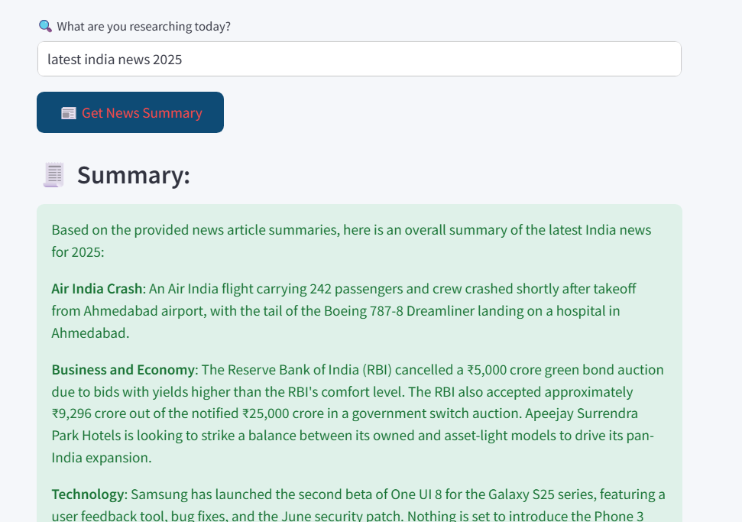
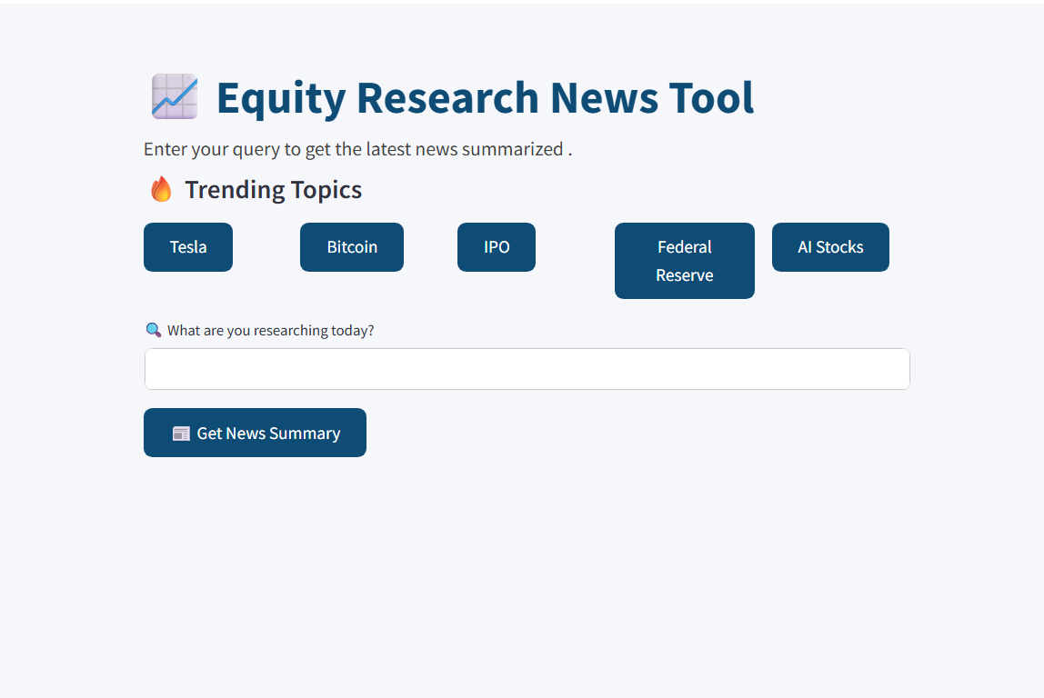
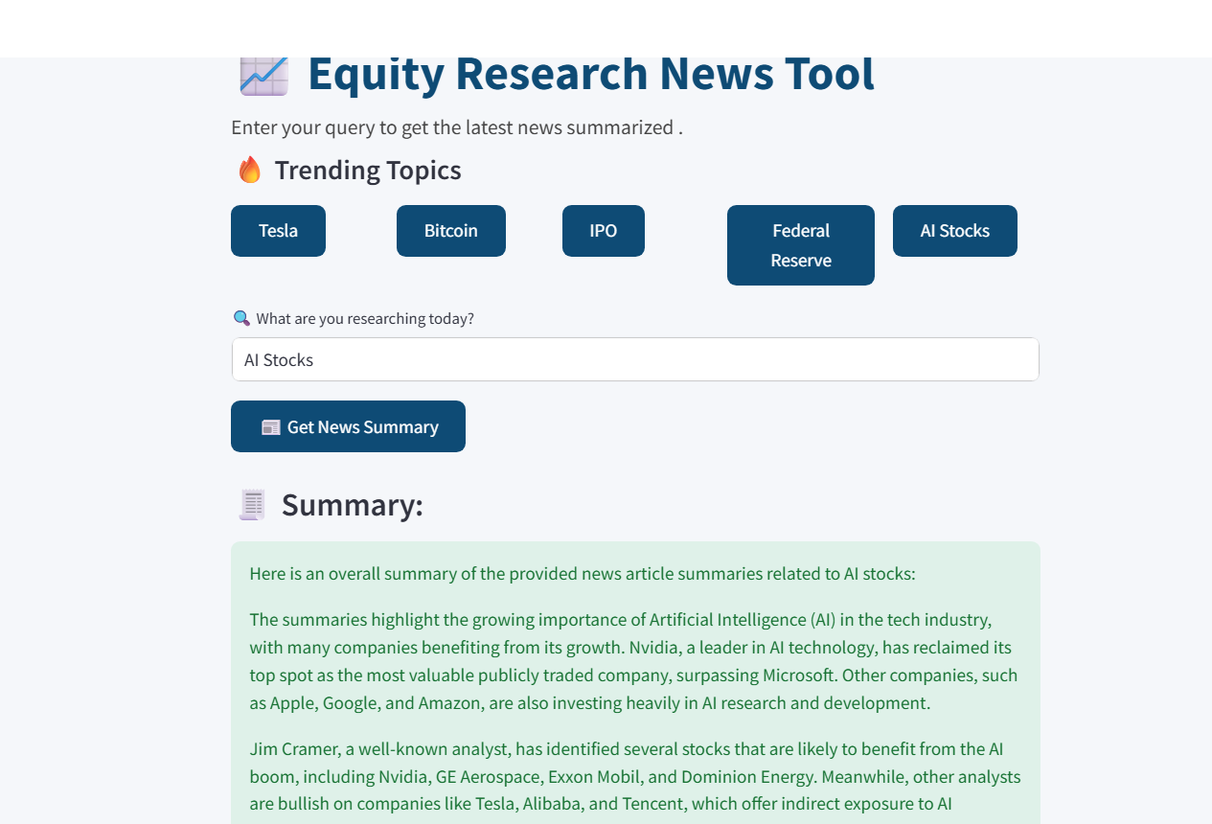
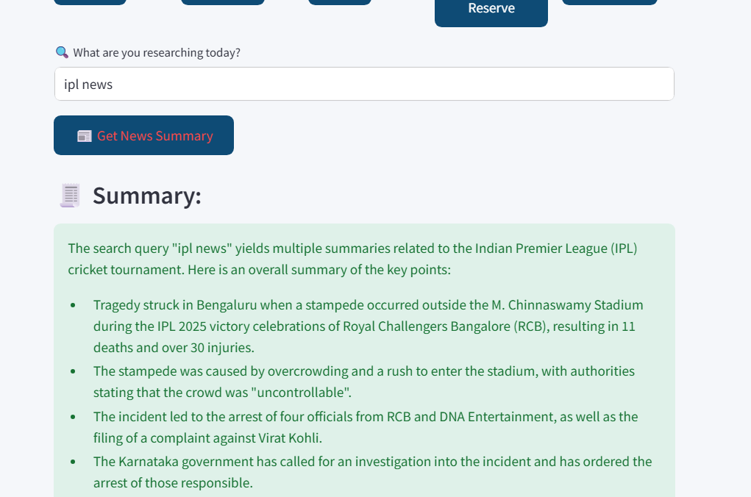
OUTPUT DEMO
"Live AI-generated summary for user query"

Slide 8
CHALLENGES
API limitations (e.g., OpenAI issue or NewsAPI fetch) so using grok api key
Ensuring meaningful summaries
UI responsiveness

Slide 9

FUTURE SCOPE
Live News API integration (like NewsAPI, Google News)
Topic clustering
Sentiment analysis
Email alerts for custom queries

Slide 10
CONCLUSION
Built a working AI tool
Helps users consume news faster
Easily deployable and extendable

Slide 11

Thank you

